Slide 1
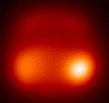
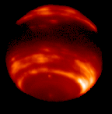
Adaptive Optics and its Applications Lecture 1
Neptune with and without AO
Claire Max AO Lecture (Modified for ASTR 257)

Slide 2
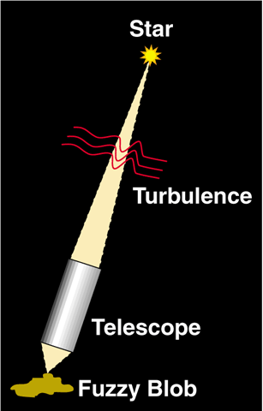
Why is adaptive optics needed?
Turbulence in earth’s atmosphere makes stars twinkle
More importantly, turbulence spreads out light; makes it a blob rather than a point
Even the largest ground-based astronomical
telescopes have no better resolution than an 8" telescope!

Slide 3
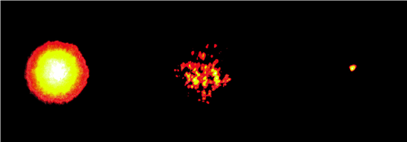
Images of a bright star, Arcturus
Lick Observatory, 1 m telescope
θ ~ 1 arc sec
θ ~ λ / D
Long exposure
image
Short exposure
image
Image with adaptive optics
Speckles (each is at diffraction limit of telescope)
Notes:
Ask what the meaning of lambda/D is

Slide 4
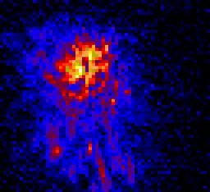
Turbulence changes rapidly with time
Image is spread out into speckles
“Speckle images”: sequence of short snapshots of a star, taken at Lick Observatory using the IRCAL infra-red camera

Slide 5
Turbulence arises in many places
stratosphere
tropopause
10-12 km
wind flow over dome
boundary layer
~ 1 km
Heat sources w/in dome
Notes:
Ask class to suggest sources of turbulence

Slide 6
Atmospheric perturbations cause distorted wavefronts
Rays not parallel
Index of refraction
variations
Plane Wave
Distorted
Wavefront

Slide 7
Optical consequences of turbulence
Temperature fluctuations in small patches of air cause changes in index of refraction (like many little lenses)
Light rays are refracted many times (by small amounts)
When they reach telescope they are no longer parallel
Hence rays can’t be focused to a point:
Point focus
Blur
Parallel light rays
Light rays affected by turbulence

Slide 8
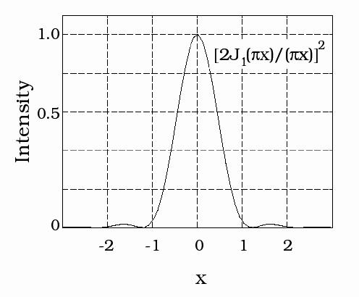
Imaging through a perfect telescope
With no turbulence, FWHM is diffraction limit of telescope, θ ~ λ / D
Example:
λ / D = 0.02 arc sec for λ = 1 μm, D = 10 m
With turbulent seeing, image size gets much larger (typically 0.5 - 2 arc sec)
FWHM ~λ/D
1.22 λ/D
in units of λ/D
Point Spread Function (PSF): intensity profile from point source

Slide 9
Characterize turbulence strength by quantity r₀
Wavefront of light
r₀
“Fried’s parameter”
Primary mirror of telescope
“Coherence Length” r₀ : distance over which optical phase distortion has mean square value of 1 rad² (r₀ ~ 15 - 30 cm at good observing sites)
r₀ = 10 cm ⎝ FWHM = 1 arc sec at λ = 0.5 μm

Slide 10
Effect of turbulence on image size
If telescope diameter D >> r₀ , image size of a point source is λ / r₀ >> λ / D
r₀ is diameter of the circular pupil for which the diffraction limited image and the seeing limited image have the same angular resolution.
Any telescope with diameter D > r₀ has no better spatial resolution than a telescope for which D = r₀ (!)
λ / D
“seeing disk”
λ / r₀

Slide 11
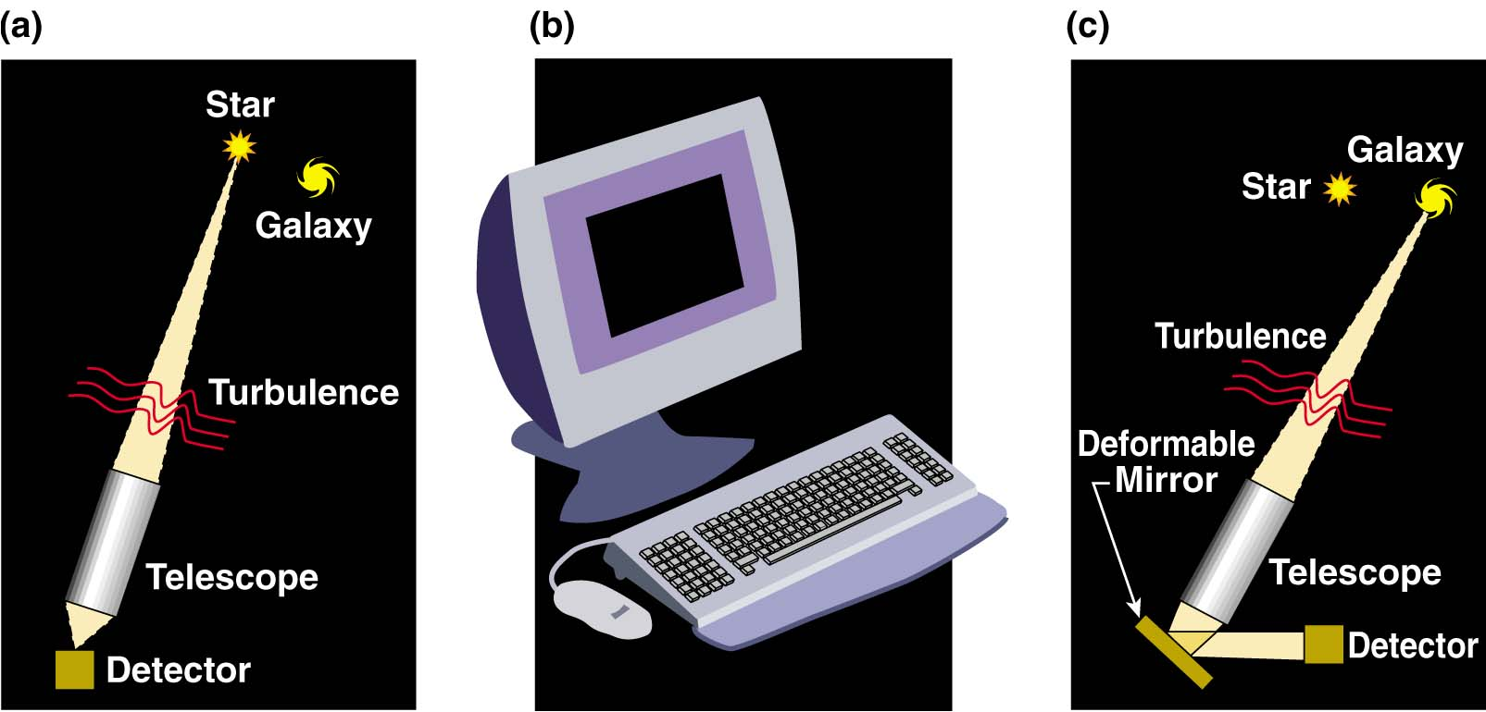
How does adaptive optics help? (cartoon approximation)
Measure details of blurring from “guide star” near the object you want to observe
Calculate (on a computer) the shape to apply to deformable mirror to correct blurring
Light from both guide star and astronomical object is reflected from deformable mirror; distortions are removed

Slide 12
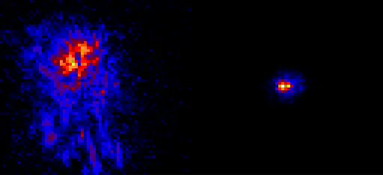
Infra-red images of a star, from Lick Observatory adaptive optics system
No adaptive optics
With adaptive optics
Note: “colors” (blue, red, yellow, white) indicate increasing intensity

Slide 13
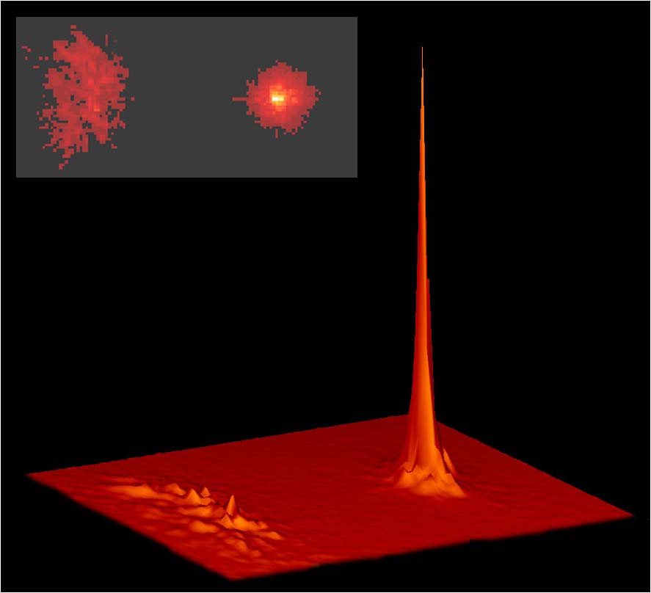
Adaptive optics increases peak intensity of a point source
Lick Observatory
No AO
With AO
Intensity
No AO
With AO

Slide 14
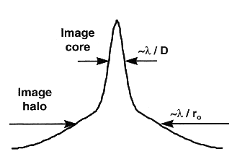
AO produces point spread functions with a “core” and “halo”
Definition of “Strehl”:
Ratio of peak intensity to that of “perfect” optical system
Intensity
x
When AO system performs well, more energy in core
When AO system is stressed (poor seeing), halo contains larger fraction of energy (diameter ~ r₀)
Ratio between core and halo varies during night

Slide 15
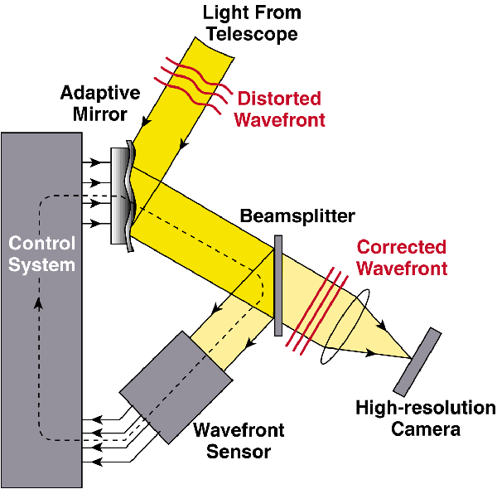
Schematic of adaptive optics system
Feedback loop: next cycle corrects the (small) errors of the last cycle

Slide 16
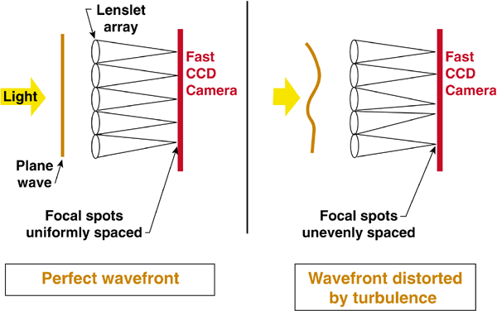
How to measure turbulent distortions (one method among many)
Shack-Hartmann wavefront sensor

Slide 17
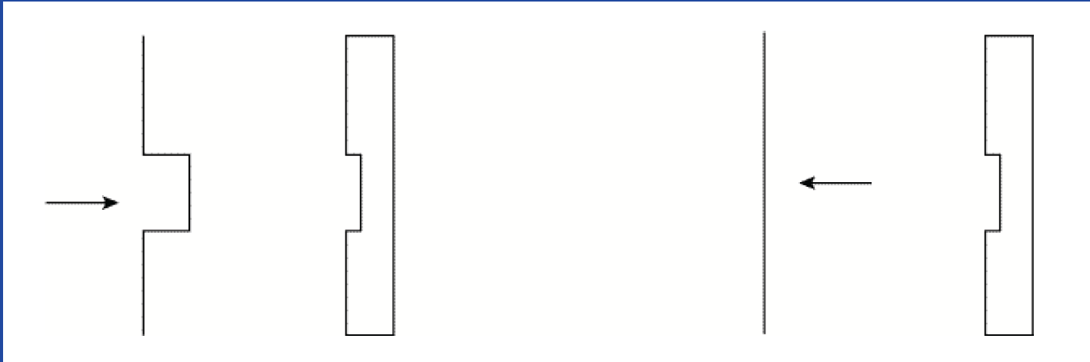
How a deformable mirror works (idealization)
BEFORE
AFTER
Incoming Wave with Aberration
Deformable Mirror
Corrected Wavefront

Slide 18
Deformable Mirror for Real Wavefronts

Slide 19
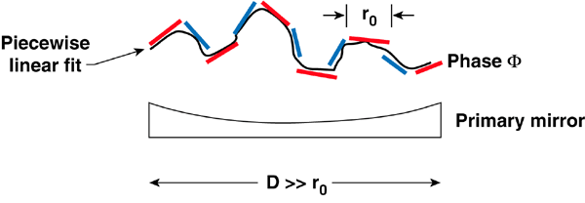
Real deformable mirrors have smooth surfaces
In practice, a small deformable mirror with a thin bendable face sheet is used
Placed after the main telescope mirror

Slide 20
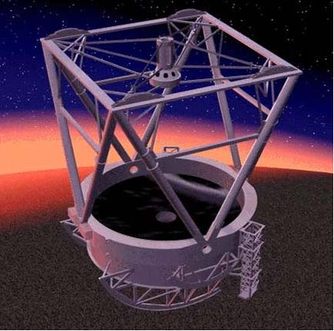
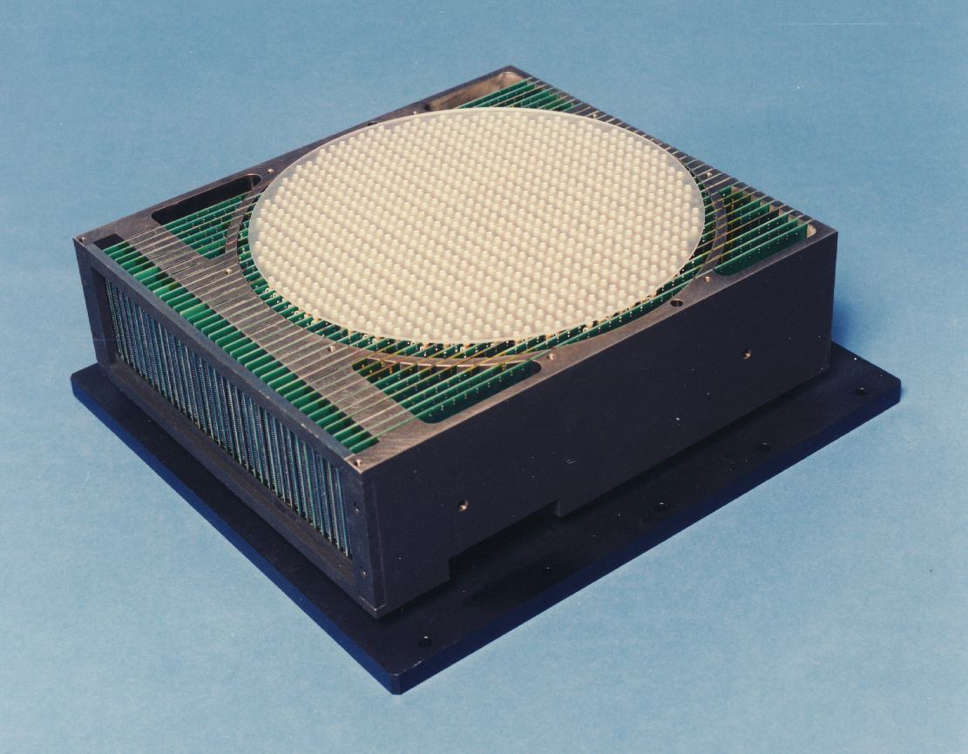
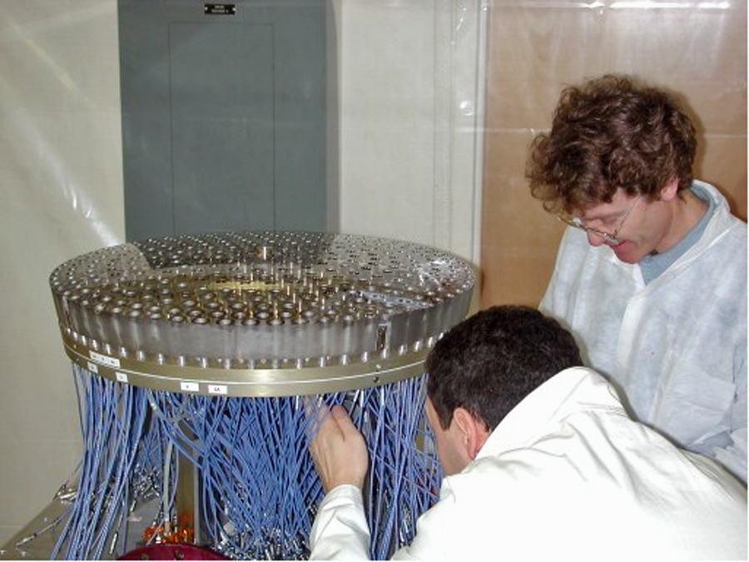
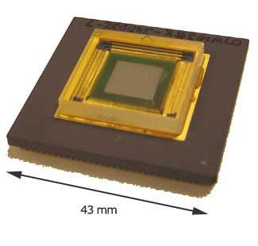
Deformable mirrors come in many sizes
Glass facesheet 1000 actuators
Adaptive Secondary Mirrors
30 cm
Xinetics
MEMS 1000 actuators
Boston Micro- Machines
1 cm
U Arizona

Slide 21
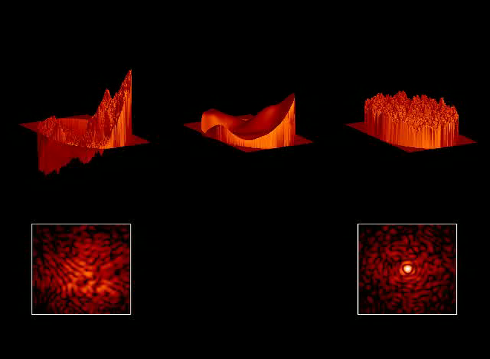
Incident wavefront
Shape of
Deformable Mirror
Corrected wavefront
Log (intensity)
Log (intensity)
Credit: J. Lloyd

Slide 22
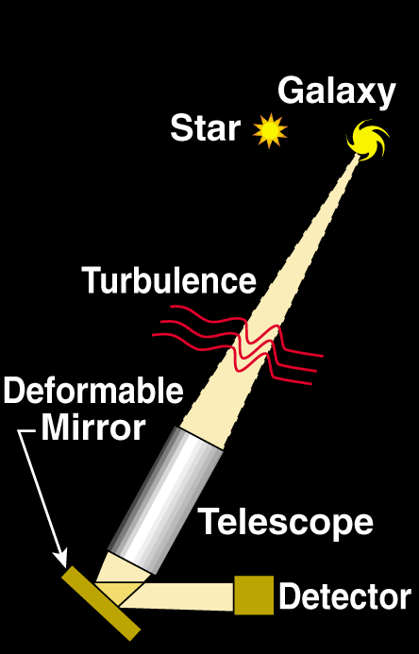
If there’s no close-by “real” star, create one with a laser
Use a laser beam to create artificial “star” at altitude of 100 km in atmosphere

Slide 23
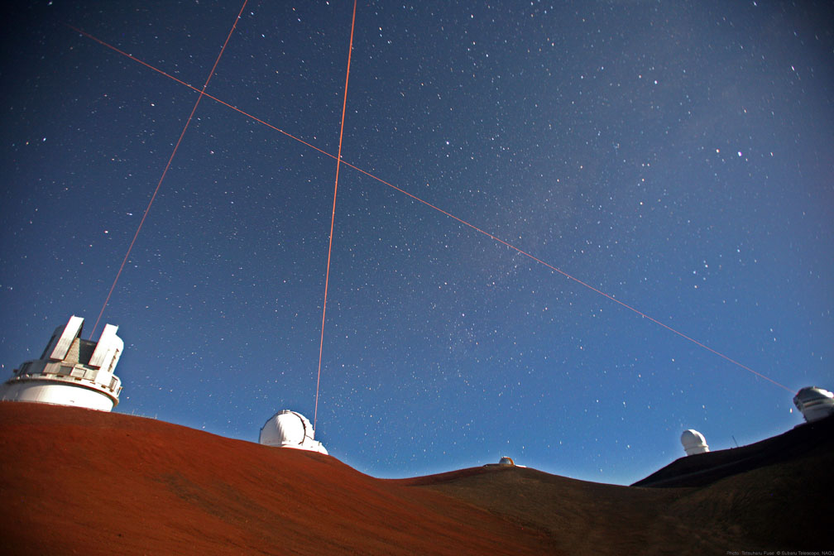
Laser guide stars are operating at Lick, Keck, Gemini N & S, VLT, Subaru, …
Four lasers on Mauna Kea: Keck 1 and 2, Gemini, Subaru telescopes

Slide 24
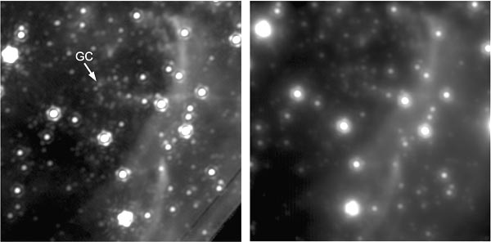
Galactic Center with Keck laser guide star
(GC is location of supermassive black hole)
Keck laser guide star AO
Best natural guide star AO
Source: UCLA Galactic Center group

Slide 25
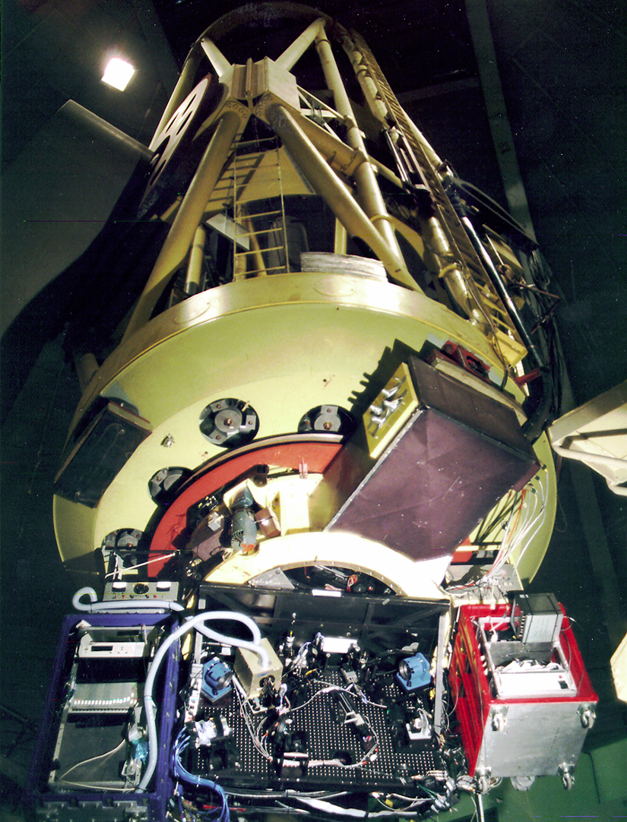
Adaptive optics system is usually behind the main telescope mirror
Example: AO system at Lick Observatory’s 3 m telescope
Support for main
telescope mirror
Adaptive optics package below main mirror

Slide 26
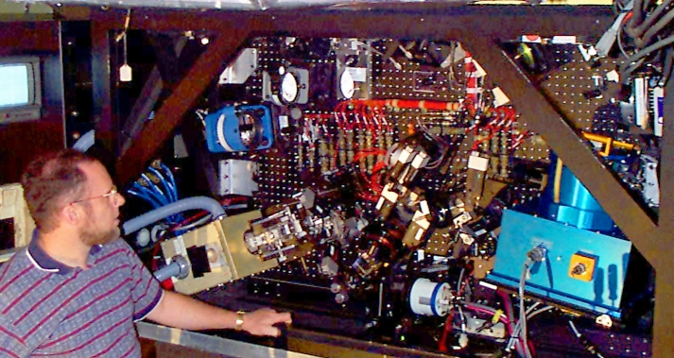
Original Lick adaptive optics system at 3m Shane Telescope
DM
Off-axis parabola mirror
IRCAL infra-red camera
Wavefront sensor

Slide 27
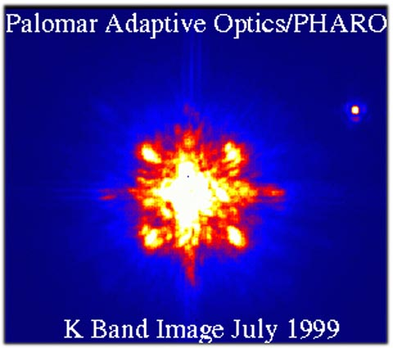
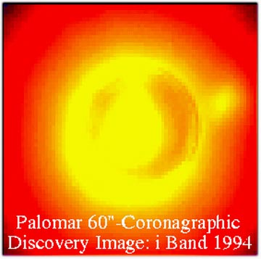
Adaptive optics makes it possible to find faint companions around bright stars
Two images from Palomar of a brown dwarf companion to GL 105
200” telescope
No AO
With AO
Credit: David Golimowski

Slide 28
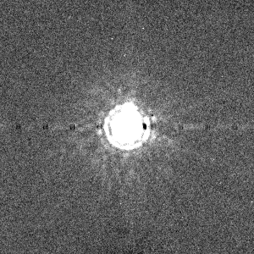
Raw Images

Slide 29
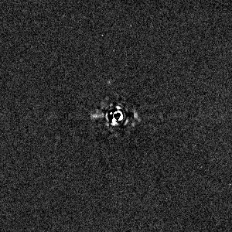
Raw Images with the Star Removed

Slide 30
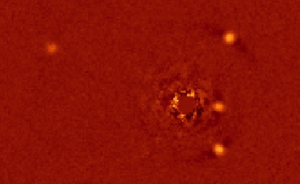
Planets!

Slide 31
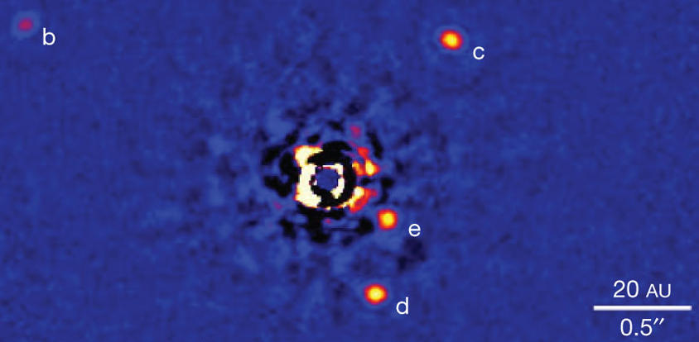
Four-planet system HR 8799
Marois et al. 2007

Slide 32
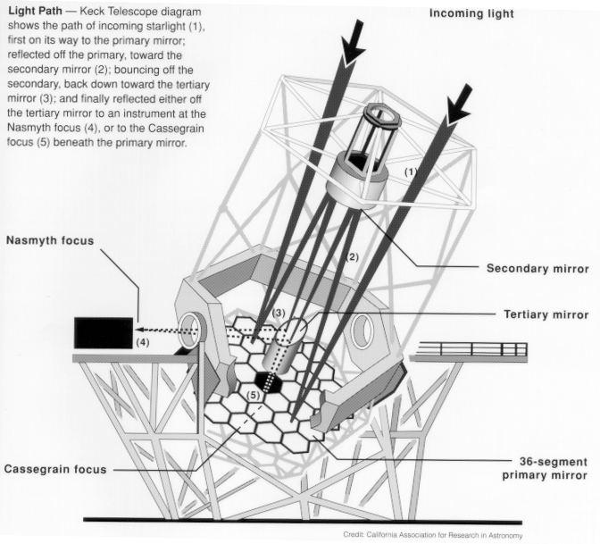
The Keck Telescopes
Adaptive optics
lives here

Slide 33
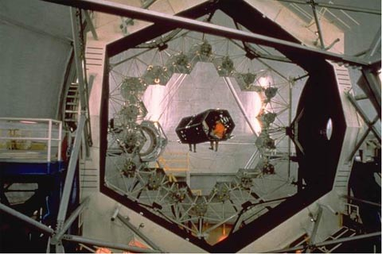
Keck Telescope’s primary mirror consists of 36 hexagonal segments
Nasmyth
platform
Person!

Slide 34
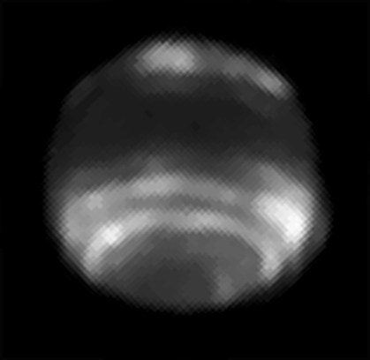
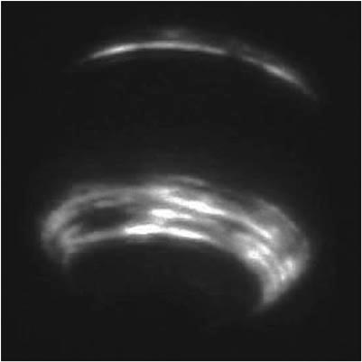
Neptune at 1.6 μm: Keck AO exceeds resolution of Hubble Space Telescope
HST – NICMOS Keck AO
~ 2 arc sec
2.4 meter telescope
10 meter telescope
(Two different dates and times)

Slide 35
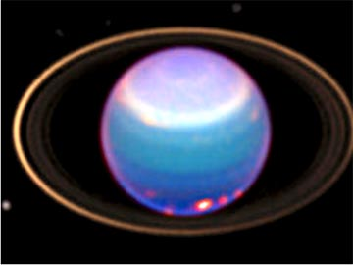
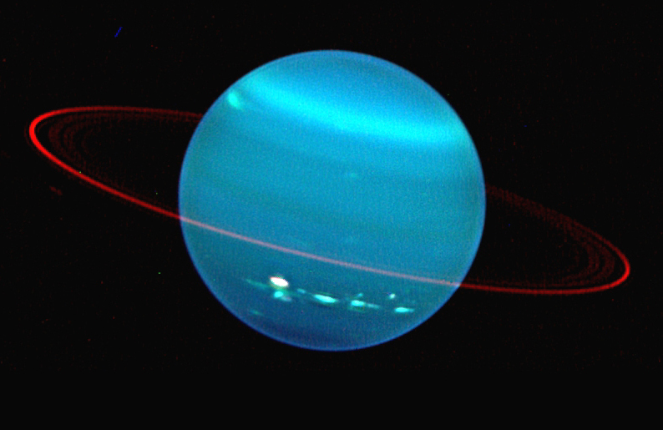
Uranus with Hubble Space Telescope and Keck AO
L. Sromovsky
HST, Visible
Keck AO, IR
Lesson: Keck in near IR has ~ same resolution as Hubble in visible

Slide 36
Your Job: Take AO Images of Neptune with Shane-AO and ShARCs
Image at 3 wavelengths and make a 3-color version of this AO-on AO-off comparison

